Slide 1
Swachhata Abhiyan
By:-
KUSHAL RAWANI

Slide 2
PROBLEM STATEMENT
There is tremendous need of cleanliness in our locality. Though people are prity much aware of the problem but still it is necessary in urban areas as well as in rural areas. This app will help people to keep clean your locality. By using this app people can selects the kind of problems they are facing in their locality like drainage, potholes, garbage, dustbin requirement they have to just click photos of the problem and attatched it with the message and comment the exact address. This message will be received by admin and then admin will sent him an acknowledgement number and estimate time for solving the issues. User can selects multiple problems also.

Slide 3
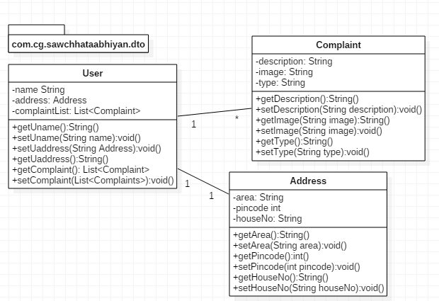
POJO CLASSES

Slide 4
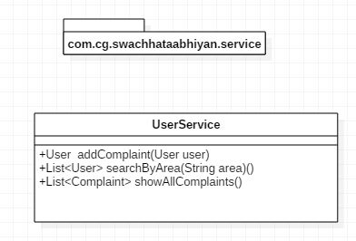
SERVICE CLASSES

Slide 5
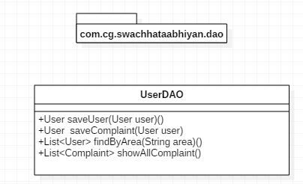
REPOSITORY CLASSES

Slide 6
THANK YOU…..

